Slide 1
BASEF
MERIT JUDGES TRAINING PRESENTATION
Rev – Feb. 21, 2026

Slide 2
Welcome to the BASEF training session
Judging is one of the most important parts of any Science Fair.
As a Merit judge, you are acting as a role model. You may well be the first professional they have met that does science/engineering for a living.
We believe that the interactions you have with the students is far more important than the selection of award winners.
After all, entering a regional science fair project is a process as well as an event.

Slide 3

BASEF Merit Judging Team
The team includes:
Judge in Chief,
Data manager/registrar,
Assistant Judge in Chief,
Category chairs – the projects are grouped into categories (following CWSF and ISEF guidelines), each group has a group leader, the Category chair
Merit judges
Additionally, there are over 100 Special Awards Judges –
judges for specific criteria/awards

Slide 4
Today we will be:
Reviewing the timelines for students and judges
Outlining the role of Merit Judges
Discussing the Judging score sheet
Discussing the Judging assignments & marks submission
Reviewing confidentiality
Sharing hints on Merit judging
Taking questions from you

Slide 5
IMPORTANT JUDGING DATES:
Student registration closes February 25, 2026
Merit Judges receive their assignments by March 9, 2026
Merit Judging at Hillfield Strathallan College, Hamilton, Thursday March 12, 2026
Open house, Saturday March 14, 2026, 9am - 12pm
Awards night at Ancaster Memorial Arts Centre, Tuesday March 24, 2026, 7 – 9 pm

Slide 6
ROLES OF MERIT JUDGES
Assist in the selection of projects that receive awards and medals
Be a Role model for your chosen career, area of study
Promote STEM education and careers
Encourage students to continue their interest in science and engineering

Slide 7
Judges Resources
Event schedule – includes judging times https://www.basef.ca/calendar/
Description of student project levels and divisions https://www.basef.ca/levels-and-divisions/
Judging form BASEF-Merit-Judging-Form-MASTER.pdf
Under the “Getting Started” header you will find all the resources available to students organized by their level
Project resources list. - gives support to all students and their parents and teachers https://www.basef.ca/project-resources/
Eligibility rules are listed at https://www.basef.ca/eligibility-rules/
FYI – the 2026 Fair limit is 14 projects per school per level.

Slide 8
Evaluation Criteria Score
Criterion 1 – Scientific Thought | / 45
Criterion 2 – Student Engagement | / 5
Criterion 3 – Scientific Communication | / 50
Score TOTAL | / 100

Slide 10
CRITERIA 1 – Scientific Thought Use the rubric provided to determine the score of the project by matching the description with the project.

Slide 12
CRITERIA 2 –

Slide 13
CRITERIA 3 –

Slide 14
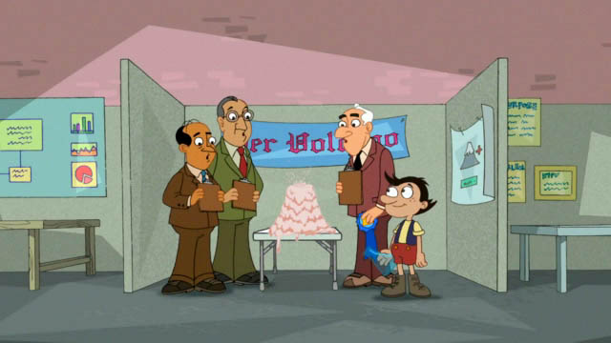
Judges Comments Sharing your thoughts matters
Overall Impressions: Please add any comments or impressions that you have about the project which you found particularly compelling.
Areas for Improvement: Explain how the participants could have scored higher. Your comments may be used to provide feedback to the judging committee and to participants who ask for tips to improve a project.

Slide 15
Remember – as a Merit Judge you represent professional authority. Therefore, it is imperative that you conduct yourself in an appropriate manner. Questions, suggestions and comments made should always provide encouragement for continued effort.

Slide 16
No Scientific research is totally original.
As a Merit Judge you are asked to give attention to the individual contribution by the student.
They should be neither penalized nor rewarded for receiving help that is properly acknowledged.

Slide 17

Be consistent with your scoring – every judge scores a little differently, however, by being familiar with our scoring sheet we hope to minimize those differences between judges and more accurately score the projects.

Slide 18
Where to begin….
Review your assigned projects - any conflicts?
On the day – become familiar with the layout of the projects
Morning judging – the purpose is to become familiar with all aspects of the project being presented. There is no schedule times for the morning.
Afternoon judging – Interview the students, ask them questions about their research, design and findings. Follow the schedule times in the afternoon.
Recording – once all marks are tabulated you will be given a secure link to record all your marks and comments.
NOTE – all judging is be done independently.
You are encouraged to discuss the projects with your fellow judges and category chair over lunch and at the end of the day.

Slide 19
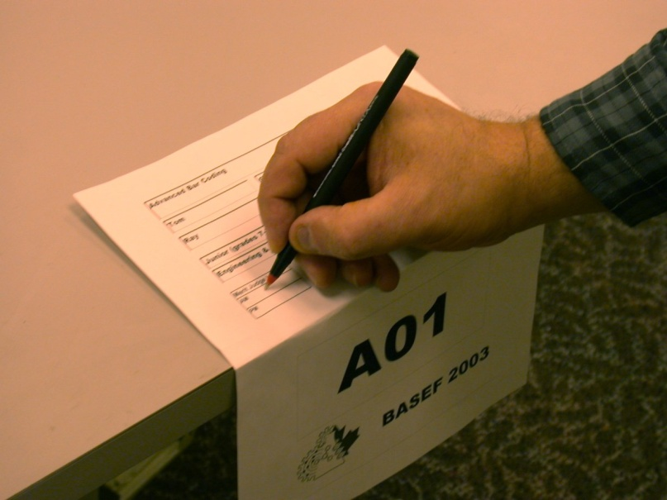
The Judges Project Sign-In Sheet
Each project has a Judges Sign-In Sheet.
Please initial each project sheet twice – once in the morning and again in the afternoon.

Slide 20

Judging assignment – Assigned Projects & Submitting marks

Slide 21
Day of Judging
What to Wear?
Dress casual / office attire
Comfortable shoes
Bring a sweater
What to Bring?
Pencil and pens (calculator)
Ipad, cell phone (to input scores)
Watch ( or use your cell phone)
Clipboard if possible
Plan on arriving by 8 am.
There will be a registration area – find your package.
In it will be a name badge to be worn at all times, judging sheets and general information sheet.
Find your Group table (located beside your name on your envelope) and introduce yourself
to your Category Chair.

Slide 22
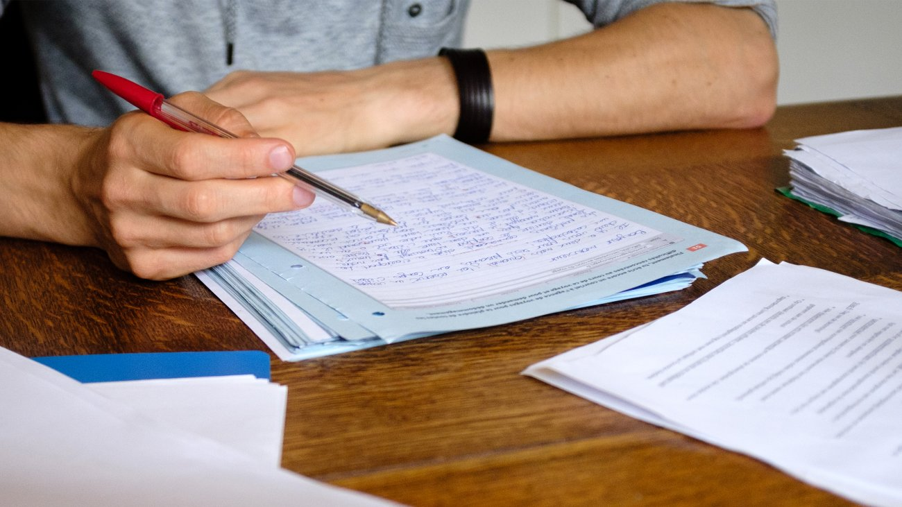
Judging Hints….
From the Judge in Chief and Judging Committee ….
From others…..
Criteria missing? … what to do….
Remember what you say to the students will be remembered and quoted!

Slide 23

Confidentiality of Information

Slide 24
Q & A
Over to you… what questions, concerns or comments do you have?

Slide 25

Thank you!
Student finalists overwhelmingly say that the most significant interactions that they have at the fair are with the judges.
Likewise, judges find their discussions with these outstanding students to be positive and uplifting experiences.
Ideally students grow academically and personally from their experience at BASEF.

