Slide 1



Slide 2

Welcome to the
2023
Bay Area Science & Engineering Fair
sponsored by
Notes:
Opening remarks

Slide 4
Platform Guests

Slide 5

Our Host

Slide 6
Our Sponsors

Slide 7
Title Sponsor

Slide 8

Diamond Sponsors

Slide 9
Diamond Sponsors

Slide 10


Platinum Level Sponsors

Slide 11


Gold Level Sponsors

Slide 12





Silver Level Sponsors

Slide 13




Silver Level Sponsors

Slide 14




Bronze Level Sponsors

Slide 15



Bronze Level Sponsors

Slide 16




Bronze Level Sponsors

Slide 17


Friends of BASEF

Slide 18
Banting and Best ($1000+)
Mike McNally
Bondar ($500+)
Marvin Cohen
Steve & Cathy Hayman
Susan & Peter Olynyk
Janet McNaught
Polanyi ($200+)
Helen Barton Dan & Debbie Bowman
Dr. Nicola Simmons Steven Brent & Family
Dana Bee Paul & Pam Lakin
John & Eleanor O'Flynn
McGill ($50+)
Jim Casey Linda Millar
In addition, BASEF has received donations from a number of individuals
who wish to remain anonymous
Benefactors

Slide 19
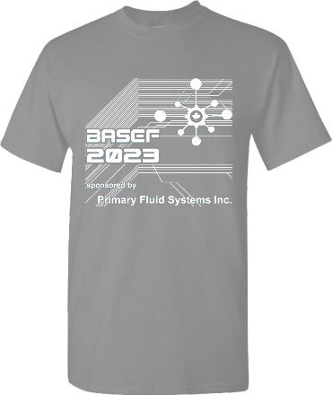
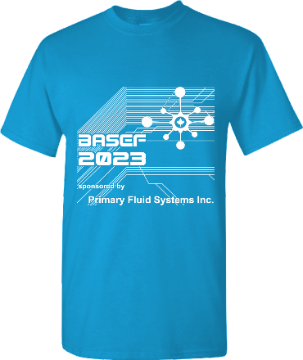
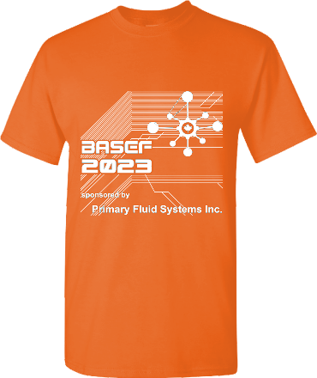
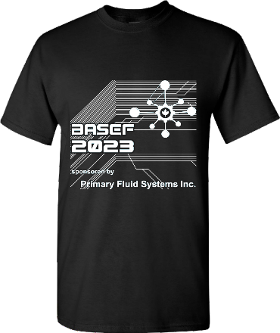
Committee
Volunteers
Safety
Inspectors
Registration
Our Volunteers

Slide 20
Are you ready?

Slide 21

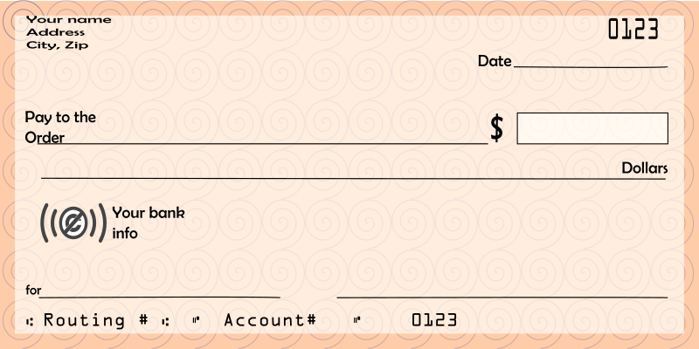

Deposit those cheques!
Winning Students will receive one cheque only

Slide 22
Instructions
Donors/presenters make their way to the stage from the bottom left.
Students: When we call your name, proceed to the bottom right of the stage.
Donors
Students

Slide 23
Special
Awards

Slide 24
ArcelorMittal Dofasco Awards

Slide 25
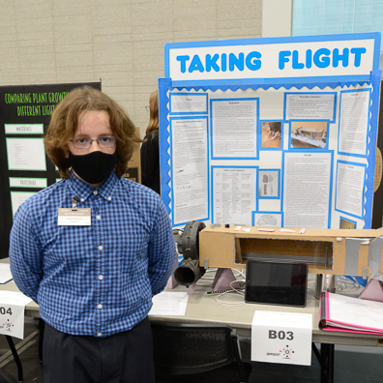
ArcelorMittal Dofasco Central Trades & Services Department Award
Isaiah Sienna
B03
Taking Flight: The Evolutionary Origin of Feathered Flight
St. Augustine
Dundas

Slide 26
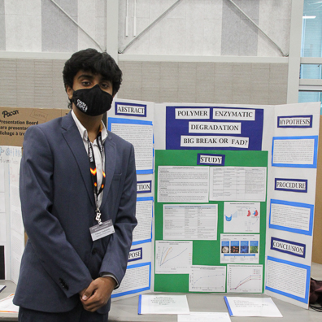
ArcelorMittal Dofasco Chemical Testing Award
Vihaan Vashishtha
F06
Polymer Enzymatic Degradation - Big Break or Fad?
White Oaks Secondary School
Oakville

Slide 27
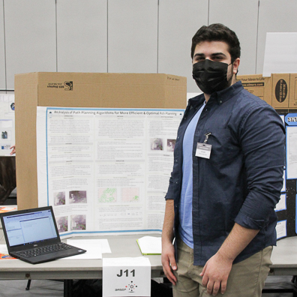
ArcelorMittal Dofasco Commercial Department Award
Ali Kefel
J11
An Analysis of Path Planning Algorithms like D* for more Efficient and Optimal Missions
Westdale Secondary School
Hamilton

Slide 28
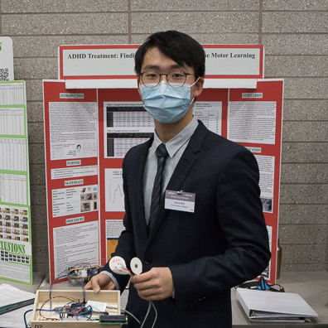
ArcelorMittal Dofasco Engineering Award
Jason Bae
P10
ADHD Treatment: Finding the Effectiveness of Fine Motor Learning on Attention Levels
King's Christian Collegiate
Oakville

Slide 29
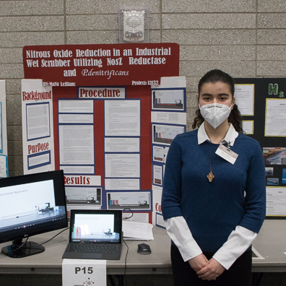
ArcelorMittal Dofasco Environment Award
Maya LeBlanc
P15
Nitrous Oxide Reduction in an Industrial Wet Scrubber Utilizing NosZ Reductase and P. denitrificans
Abbey Park High School
Oakville

Slide 30
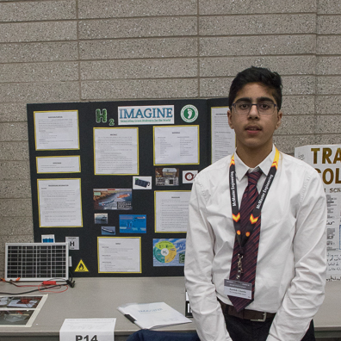
ArcelorMittal Global R&D Hamilton Award for Outstanding Research
Karthik Chawla
P14
Imagine - Generating Green hydrogen for the world
W. H. Morden Public School
Oakville

Slide 31
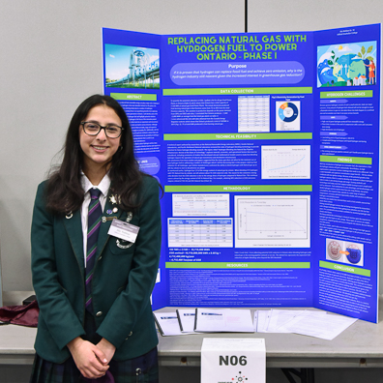
ArcelorMittal Global R&D Hamilton Award for Technology Application
Alia Wahban
N06
Replacing Natural Gas with hydrogen Fuel to Power Ontario (Phase 1)
Hillfield Strathallan College
Hamilton

Slide 32
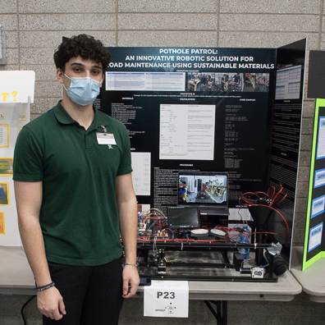
ArcelorMittal Dofasco Hot Mill Award
Anthony Saturnino
P23
Pothole Patrol: An Innovative Robotic Solution for Road Maintenance Using Sustainable Materials
Bishop Ryan Secondary School
Hannon

Slide 33
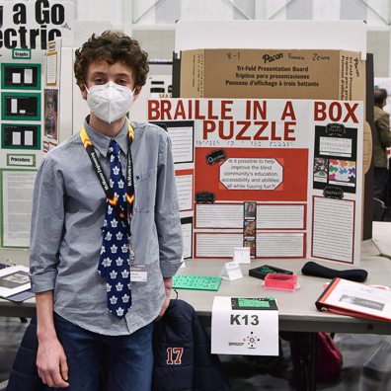
ArcelorMittal Dofasco Human Resources Training & Development Award
Ethan Horn
K13
Braille In A Box Puzzle
Rolling Meadows Public School
Burlington

Slide 34
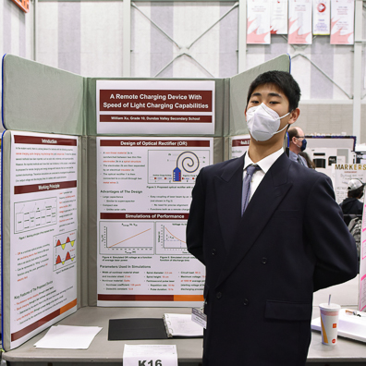
ArcelorMittal Dofasco Information Systems Award
William Xu
K16
A Remote Charging Device With Speed of Light Charging Capabilities
Dundas Valley Secondary School
Dundas

Slide 35
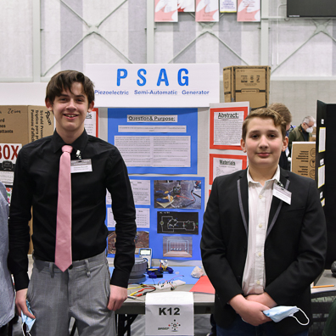
ArcelorMittal Dofasco Ironmaking Award
Gavin Mckerracher & Grayson Beecroft
K12
PSAG (Piezoelectric Semi-Automatic Generator)
Rolling Meadows Public School
Burlington

Slide 36
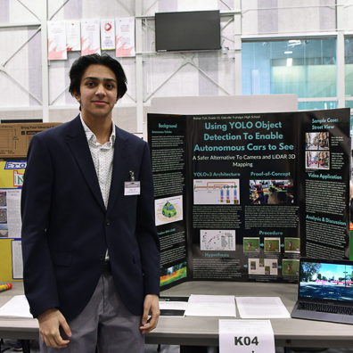
ArcelorMittal Dofasco Material Handling & Logistics Department Award
Rohan Tuli
K04
Using YOLO Object Detection To Allow Self-Driving Cars to See
Oakville Trafalgar High School
Oakville

Slide 37
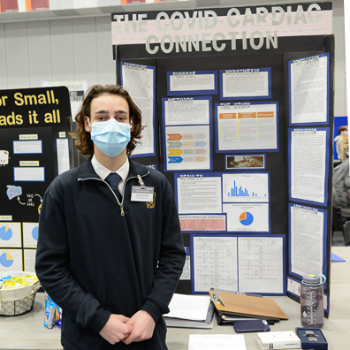
ArcelorMittal Dofasco Medical Department Award
Nicholas Pacifici
E13
The COVID Cardiac Connection: A Novel Pre-participation Screening Tool
St. Mary Secondary School
Hamilton

Slide 38
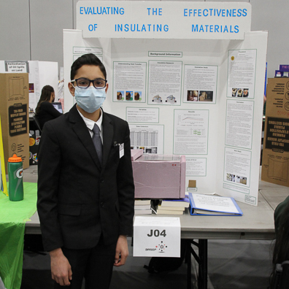
ArcelorMittal Dofasco Pickling and Cold Rolling Award
Eesa Latif
J04
Investigating the Effectiveness of Insulation
Al-Falah Islamic School
Oakville

Slide 39
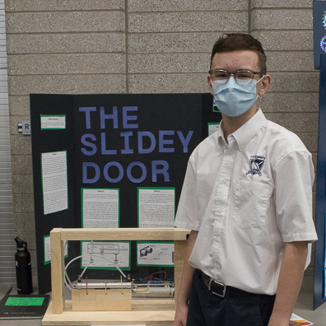
ArcelorMittal Dofasco Process Automation Award
Deaglan Doyle
P18
The Slidey Door
Lee Academy
Lynden

Slide 40
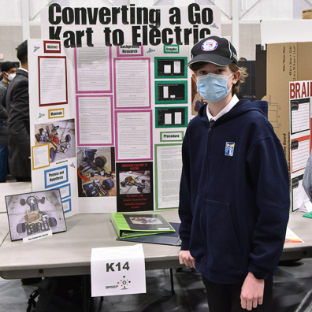
ArcelorMittal Dofasco Product Development Business Process Award
Dylan Jagt
K14
Converting a Go Kart to Electric
Oakville Christian School
Oakville

Slide 41
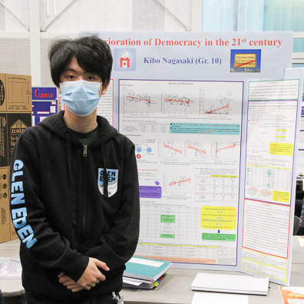
ArcelorMittal Dofasco Quality Systems Award
Kibo Nagasaki
H02
Deterioration of Democracy in the 21st Century
Mentor College
Mississauga

Slide 42
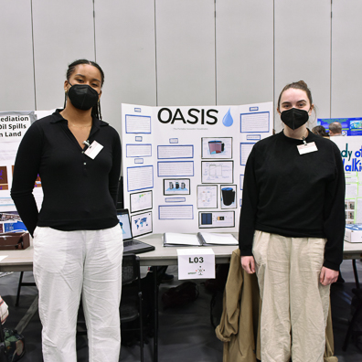
ArcelorMittal Dofasco Steelmaking Award
Gladys Kozyra & Emilia Diaz-Ruiz
L03
Oasis: The portable seawater desalinator
Westdale Secondary School
Hamilton

Slide 43
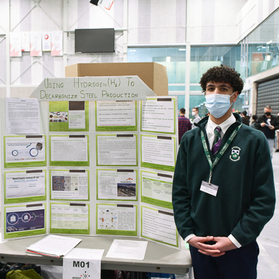
ArcelorMittal Dofasco Smarter Steels for People and Planet Award
Ruhan Soni
M01
Using Hydrogen to decarbonize Steel Production
Hillfield Strathallan College
Hamilton

Slide 44
Artistically Inspired Display Awards

Slide 45
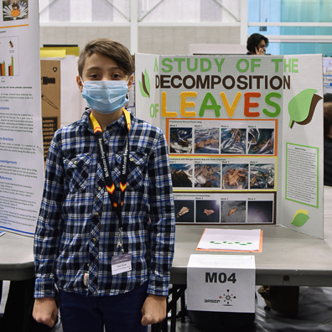
Artistically Inspired Display Award
Noah DiCaro
M04
A study of the decomposition of leaves
Our Lady of Victory Elementary School
Milton

Slide 46
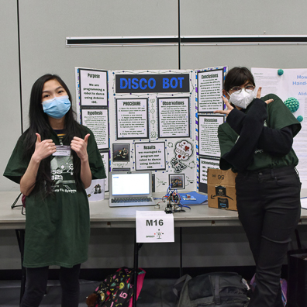
Artistically Inspired Display Award
Redina Nijjar & Michelle Huang
M16
Disco Bot
Cathy Wever
Hamilton

Slide 47
Association for Iron & Steel Technology Northern Chapter Awards

Slide 48
Association for Iron & Steel Technology Northern Chapter Award
Ruhan Soni
M01
Using Hydrogen to decarbonize Steel Production
Hillfield Strathallan College
Hamilton

Slide 49
Association for Iron & Steel Technology Northern Chapter Award
Maya LeBlanc
P15
Nitrous Oxide Reduction in an Industrial Wet Scrubber Utilizing NosZ Reductase and P. denitrificans
Abbey Park High School
Oakville

Slide 50
Bay Area Health Trust Scholarship / Paul Lakin Life Sciences Award

Slide 51
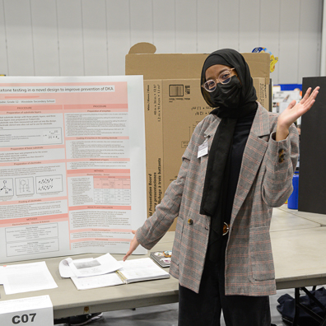
Bay Area Health Trust Scholarship, Paul Lakin Life Sciences Award
Isra Bashir
C07
Sugar High! - Integrating glucose and ketone testing in a novel design to improve prevention of DKA
Westdale Secondary School
Hamilton

Slide 52
Dr. Laura Blew Social Sciences Awards

Slide 53
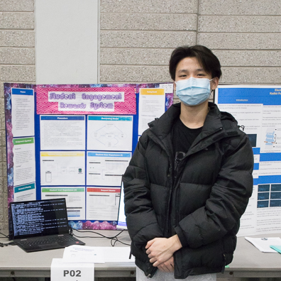
Dr. Laura Blew Social Sciences Award
Brian Yin
P02
Student Engagement Rewards System
Iroquois Ridge High School
Oakville

Slide 54
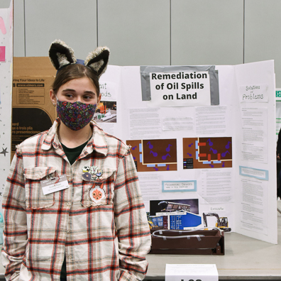
Dr. Laura Blew Social Sciences Award
Evelyn Peart
L02
Remediation of oil spills on land
Tiger Jeet Singh Public School
Milton

Slide 55
Canadian Institute of Mining, Metallurgy and Petroleum (Hamilton Branch) Awards

Slide 56
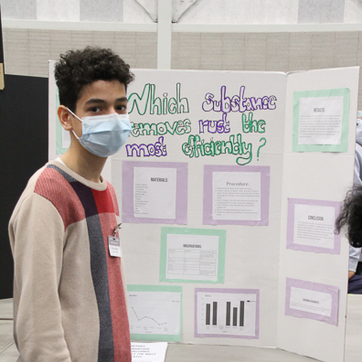
Canadian Institute of Mining, Metallurgy and Petroleum (Hamilton Branch) Award
Daniel Mansour
H06
What Substance Removes Rust The Best
Al-Falah Islamic School
Oakville

Slide 57
Canadian Institute of Mining, Metallurgy and Petroleum (Hamilton Branch) Award
Evelyn Peart
L02
Remediation of oil spills on land
Tiger Jeet Singh Public School
Milton

Slide 58
Canadian Meteorological and Oceanographic Society Awards

Slide 59
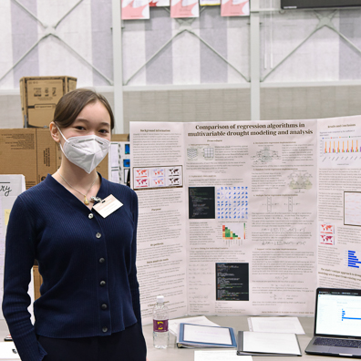
Canadian Meteorological and Oceanographic Society (CMOS) Award - Second
Maria Chzhen
K09
Comparison of regression algorithms for multivariable drought analysis
Westdale Secondary School
Hamilton

Slide 60
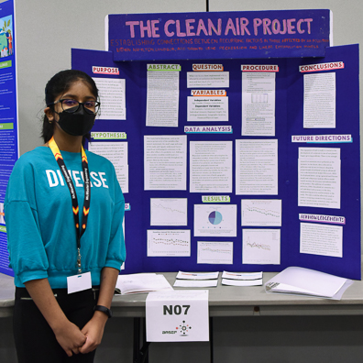
Canadian Meteorological and Oceanographic Society (CMOS) Award - First
Joanna Martin
N07
The Clean Air Project
St. John Elementary School (Burlington)
Burlington

Slide 61
Canadian Nuclear Society (Golden Horseshoe Branch) Awards

Slide 62
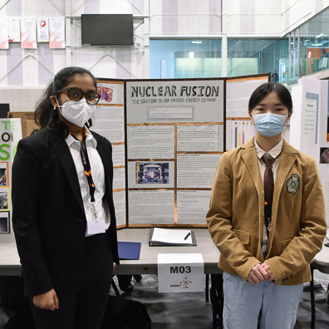
Canadian Nuclear Society (Golden Horseshoe Branch) Awards - Junior
Bhavitha Kolla & Jianyu Yu
M03
Nuclear Fusion - The Long-Term Solution to Our Massive Energy Demand
W. H. Morden Public School
Oakville

Slide 63
Canadian Nuclear Society (Golden Horseshoe Branch) Awards - Junior
Karthik Chawla
P14
Imagine - Generating Green hydrogen for the world
W. H. Morden Public School
Oakville

Slide 64
Canadian Nuclear Society (Golden Horseshoe Branch) Awards - Intermediate or Senior
Alia Wahban
N06
Replacing Natural Gas with hydrogen Fuel to Power Ontario (Phase 1)
Hillfield Strathallan College
Hamilton

Slide 65
Canadian Nuclear Society (Golden Horseshoe Branch) Awards- Intermediate or Senior
Ruhan Soni
M01
Using Hydrogen to decarbonize Steel Production
Hillfield Strathallan College
Hamilton

Slide 66
Chemical Institute of Canada - Hamilton Section Awards

Slide 67
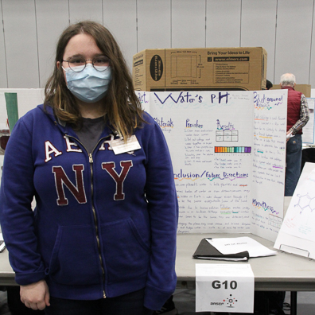
Chemical Institute of Canada (Hamilton Section) Award
Teodora Jovicevic
G10
pH Of Water
Ancaster Meadow
Ancaster

Slide 68
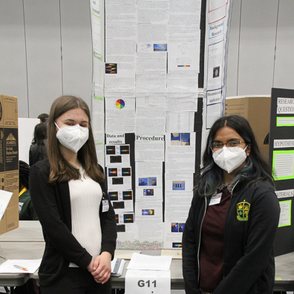
Chemical Institute of Canada (Hamilton Section) Award
Weronika Szymala & Yuba Jim
G11
Cell Phone Sectrophotometer
Bishop Ryan Secondary School
Hamilton

Slide 69
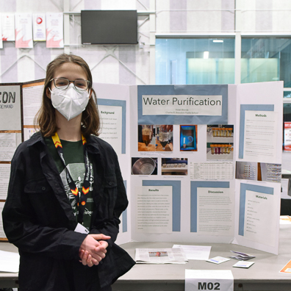
Chemical Institute of Canada (Hamilton Section) Award
Vivian Blonde
M02
Water Purification
Charles R. Beaudoin Public School
Burlington

Slide 70
Conservation Halton Awards

Slide 71
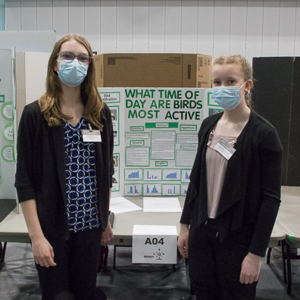
Conservation Halton Environmental Sciences Award
Rachel McKenzie & Samantha Almond
A04
What time of day are birds most active?
Charles R. Beaudoin Public School
Burlington

Slide 72
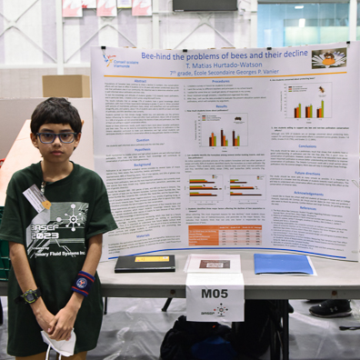
Conservation Halton Environmental Sciences Award
Thiago Matias Hurtado-Watson
M05
Bee-hind the problems of bees and their decline
École secondaire Georges-P.-Vanier
Hamilton

Slide 73
Michael G. DeGroote Institute for Infectious Disease Research Awards

Slide 74
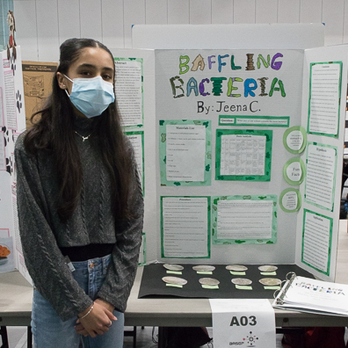
Michael G. DeGroote Institute for Infectious Disease Research Award
Jeena Chhinzer
A03
Baffling Bacteria
Dr. David R Williams
Oakville

Slide 75
Michael G. DeGroote Institute for Infectious Disease Research Award
Nicholas Pacifici
E13
The COVID Cardiac Connection: A Novel Pre-participation Screening Tool
St. Mary Secondary School
Hamilton

Slide 76
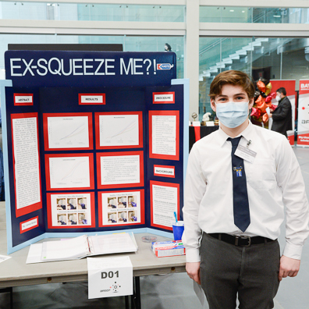
Michael G. DeGroote Institute for Infectious Disease Research Grand Award
James Kelder
D01
Ex-Squeeze Me?!
Oakville Christian School
Oakville

Slide 77
Dillon Consulting Awards

Slide 78
Dillon Consulting Science and Engineering Award
Alia Wahban
N06
Replacing Natural Gas with hydrogen Fuel to Power Ontario (Phase 1)
Hillfield Strathallan College
Hamilton

Slide 79
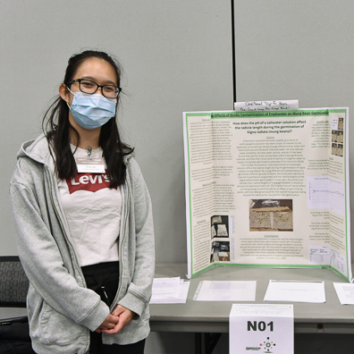
Dillon Consulting Biological Sciences Award
Hong Ngo
N01
The Effects of Acidic Contamination of Freshwater on Mung Bean Germination
Westdale Secondary School
Hamilton

Slide 80
Dr. M. Doyle Award

Slide 81
Dr. M. Doyle Biology Award
Isaiah Sienna
B03
Taking Flight: The Evolutionary Origin of Feathered Flight
St. Augustine
Dundas

Slide 82
Electrical Construction Association of Hamilton Award

Slide 83
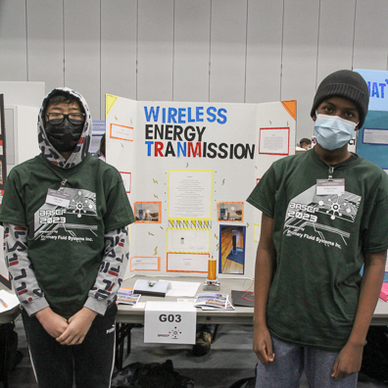
Electrical Construction Association of Hamilton Award
Farhan Noor & Ethan Mai
G03
Wireless Energy Transfer Using a Tesla Coil
Cathy Wever
Hamilton

Slide 84
Electrical Construction Association of Hamilton Award
Gavin Mckerracher & Grayson Beecroft
K12
PSAG (Piezoelectric Semi-Automatic Generator)
Rolling Meadows Public School
Burlington

Slide 85
Environmental Inspiration Award

Slide 86
Environmental Inspiration Award
Karthik Chawla
P14
Imagine - Generating Green hydrogen for the world
W. H. Morden Public School
Oakville

Slide 87
Farncombe Family Digestive Health Research Awards

Slide 88
Farncombe Family Digestive Health Research Award
Jeena Chhinzer
A03
Baffling Bacteria
Dr. David R Williams
Oakville

Slide 89
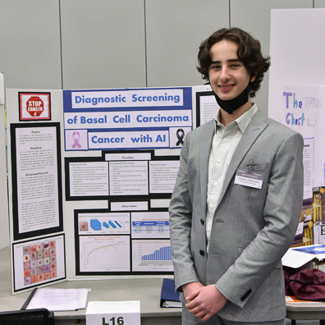
Farncombe Family Digestive Health Research Award
Anthony Efthimiadis
L16
Development of an AI Convolutional Neural Network for Diagnostic Screening of Basal Cell Carcinoma
W. H. Morden Public School
Oakville

Slide 90
Farncombe Family Digestive Health Research Institute Grand Award
Isra Bashir
C07
Sugar High! - Integrating glucose and ketone testing in a novel design to improve prevention of DKA
Westdale Secondary School
Hamilton

Slide 91
Firestone Institute for Respiratory Health Award

Slide 92
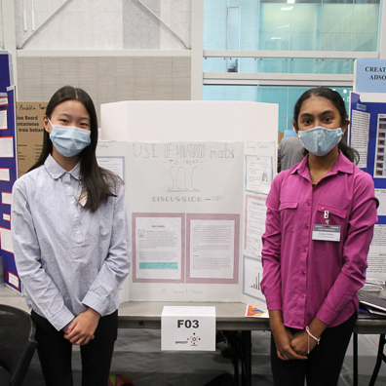
Firestone Institute Respiratory Health Award
Heather Dong & Varsha Sridhar
F03
The use of miniaturized monoclonal antibodies to treat small cell lung cancer
W. H. Morden Public School
Oakville

Slide 93
Gowling WLG Innovation Awards

Slide 94
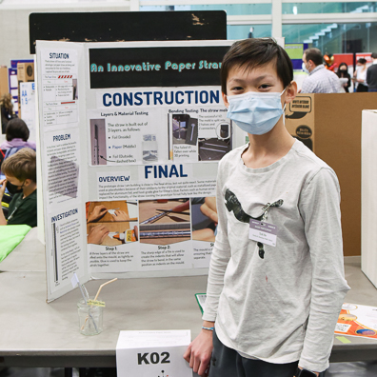
Gowlings Innovation Award - Honourable Mention
Ted He
K02
An Innovative Paper Straw
Charles R. Beaudoin Public School
Burlington

Slide 95
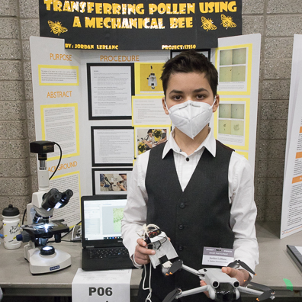
Gowling WLG Innovation Award - Runner-up
Jordan LeBlanc
P06
Transferring Pollen Using a Mechanical Bee
St. Matthew Elementary School
Oakville

Slide 96
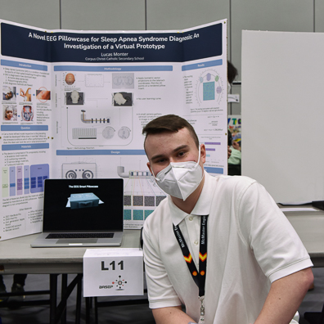
Gowling WLG Innovation Award - Grand Winner
Lucas Monter
L11
A Novel EEG Pillowcase for Sleep Apnea Syndrome Diagnosis: An Investigation of a Virtual Prototype
Corpus Christi Secondary School
Burlington

Slide 97
Hamilton Academy of Dentistry Awards

Slide 98
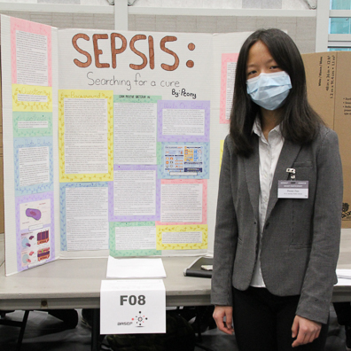
Hamilton Academy of Dentistry - Third
Peony Zuo
F08
Sepsis: Searching for a Cure
W. H. Morden Public School
Oakville

Slide 99
Hamilton Academy of Dentistry Award - Second
Anthony Efthimiadis
L16
Development of an AI Convolutional Neural Network for Diagnostic Screening of Basal Cell Carcinoma
W. H. Morden Public School
Oakville

Slide 100
Hamilton Academy of Dentistry Award - First
James Kelder
D01
Ex-Squeeze Me?!
Oakville Christian School
Oakville

Slide 101
Hamilton Amateur Astronomers Awards

Slide 102
James A. Winger Award- Junior
Janine Gong & Leah Seet
A09
Statocytes in Space
W. H. Morden Public School
Oakville

Slide 103
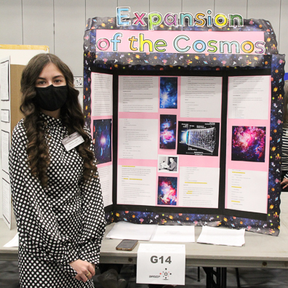
James A. Winger Award-- Senior
Isabella Lopes
G14
Expansion of the Cosmos
Bishop Ryan Secondary School
Hannon

Slide 104
Hamilton Association for the Advancement of Literature, Science & Art

Slide 105
Hamilton Association da Vinci Award
Isra Bashir
C07
Sugar High! - Integrating glucose and ketone testing in a novel design to improve prevention of DKA
Westdale Secondary School
Hamilton

Slide 106
Hamilton Chamber of Commerce Innovation Awards

Slide 107
Hamilton Chamber of Commerce Innovation Award - Third
Gladys Kozyra & Emilia Diaz-Ruiz
L03
Oasis: The portable seawater desalinator
Westdale Secondary School
Hamilton

Slide 108
Hamilton Chamber of Commerce Innovation Award - Second
Anthony Saturnino
P23
Pothole Patrol: An Innovative Robotic Solution for Road Maintenance Using Sustainable Materials
Bishop Ryan Secondary School
Hannon

Slide 109
Hamilton Chamber of Commerce Innovation Award - First
Maya LeBlanc
P15
Nitrous Oxide Reduction in an Industrial Wet Scrubber Utilizing NosZ Reductase and P. denitrificans
Abbey Park High School
Oakville

Slide 110
Hamilton Wentworth Occasional Teacher Awards

Slide 111
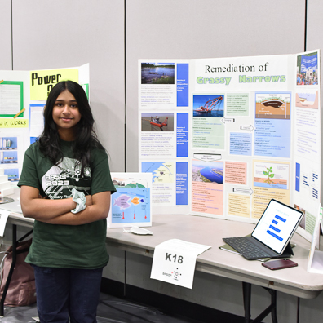
Hamilton Wentworth Occasional Teachers - Environment & Education Award
Fiza Mehfil
K18
Exploring Mercury Remediation Options for Grassy Narrows
Sam Sherratt Public School
Milton

Slide 112

Hamilton Wentworth Occasional Teacher - Healthy Lifestyles Award
Danah Alnajjar
C15
Re-think Your Energy Drink
Hawthorne Village Public School
Milton

Slide 113

Hamilton Wentworth Occasional Teacher - Presentation & Aesthetics Award
Anna Amaladoss
F18
Artificial Intelligence - The Future is now
Trinity Christian School
Burlington

Slide 114
Harrison Family Chemistry Award

Slide 115
Harrison Family Chemistry Award
Clara Jonkman
G12
Health Properties of Kombucha
Westdale Secondary School
Hamilton

Slide 116
Hillfield Strathallan College Awards of Excellence

Slide 117

Hillfield Strathallan College Awards of Excellence - Life Sciences Award
Evan Budz & Colin Cameron
N17
ePills – Set it and Forget it!
Charles R. Beaudoin Public School
Burlington

Slide 118
Hillfield Strathallan College Awards of Excellence - Scientific Process Award
Nicholas Pacifici
E13
The COVID Cardiac Connection: A Novel Pre-participation Screening Tool
St. Mary Secondary School
Hamilton

Slide 119

Hillfield Strathallan College Awards of Excellence - Innovation Award
Melin Feng & Aileen Feng
F10
Investigating the Effect of Gene Therapy on Type 1 Diabetes and its Potential as a Future Treatment
Oakville Trafalgar High School
Oakville

Slide 120
Hillfield Strathallan College Entrance Scholarship Award

Slide 121
Hillfield Strathallan College Entrance Scholarship Award
Anthony Efthimiadis
L16
Development of an AI Convolutional Neural Network for Diagnostic Screening of Basal Cell Carcinoma
W. H. Morden Public School
Oakville

Slide 122
John W. Howard Materials Research Award

Slide 123
John W. Howard Materials Research Award
Anthony Saturnino
P23
Pothole Patrol: An Innovative Robotic Solution for Road Maintenance Using Sustainable Materials
Bishop Ryan Secondary School
Hannon

Slide 124
Indigenous Peoples of Canada Scientific Study Awards

Slide 125

Indigenous Peoples of Canada Scientific Study Award - Second
Filip Veljkovic
N05
SODIS in Canada: A "Cool" Way to Disinfect Water
Charles R. Beaudoin Public School
Burlington

Slide 126
Indigenous Peoples of Canada Scientific Study Award - First
Fiza Mehfil
K18
Exploring Mercury Remediation Options for Grassy Narrows
Sam Sherratt Public School
Milton

Slide 127
IEEE (Institute of Electrical and Electronic Engineers) Hamilton Section Awards

Slide 128
IEEE (Institute of Electrical & Electronic Engineers) Hamilton Section Award
Anthony Saturnino
P23
Pothole Patrol: An Innovative Robotic Solution for Road Maintenance Using Sustainable Materials
Bishop Ryan Secondary School
Hannon

Slide 129
IEEE (Institute of Electrical & Electronic Engineers) Hamilton Section Award
Jason Bae
P10
ADHD Treatment: Finding the Effectiveness of Fine Motor Learning on Attention Levels
King's Christian Collegiate
Oakville

Slide 130
International Science & Engineering Affiliated Fair Awards

Slide 131

American Psychological Association Award
Kevin Deng
P19
Attention: A Comparison Between Visual and Auditory Stimuli Under Highly Externally Valid Conditions
Oakville Trafalgar High School
Oakville

Slide 132

The National Geographic That's Geography - Cultivating Empathy for the Earth Award
Zixuan Li
M12
Bionic Squid-inspired Robot Facilitating Underwater Monitorization and Preservation of Coral Reefs
Ridley College
St. Catharines

Slide 133
Ricoh USA, Inc. Award
Anthony Saturnino
P23
Pothole Patrol: An Innovative Robotic Solution for Road Maintenance Using Sustainable Materials
Bishop Ryan Secondary School
Hannon

Slide 134

Society for In Vitro Biology Award
Misimi Sanni
P17
Emerging Prosthetics
Appleby College
Oakville

Slide 135
U.S. Agency for International Development (USAID) Award
Isra Bashir
C07
Sugar High! - Integrating glucose and ketone testing in a novel design to improve prevention of DKA
Westdale Secondary School
Hamilton

Slide 136

Yale Science & Engineering Association Award
Aahaan Maini
M17
Circulate: Designing an Algorithmic Blood Distribution System to Tackle the Indian Blood Shortage
Oakville Trafalgar High School
Oakville

Slide 137
Laurentian Chapter of SETAC Awards

Slide 138
Laurentian Chapter of SETAC Award
Filip Veljkovic
N05
SODIS in Canada: A "Cool" Way to Disinfect Water
Charles R. Beaudoin Public School
Burlington

Slide 139

Laurentian Chapter of SETAC Award
Sam Bae
F02
Creating bioplastic that has the most effective adsorption on atmospheric aerosol particles
King's Christian Collegiate
Oakville

Slide 140
Dr. Colin J.L. Lock Memorial Chemistry Award

Slide 141

Dr. Colin J.L. Lock Memorial Chemistry Award
Akshin Makkar
J14
Optimizing Dye-Sensitized Solar Cell's (DSSC's) by Concentration Variation
King's Christian Collegiate
Oakville

Slide 142
Ola Lunyk-Child Memorial Health Awards

Slide 143

Ola Lunyk-Child Memorial Health Science Award - Third
Daniel Lu & Thomas Seoh
C14
Virtual Schooling Impacts on Adolescents' Mental Health Using the Instrumental Approach of PHQ-A
W. H. Morden Public School
Oakville

Slide 144
Ola Lunyk-Child Memorial Health Science Award - Second
Aahaan Maini
M17
Circulate: Designing an Algorithmic Blood Distribution System to Tackle the Indian Blood Shortage
Oakville Trafalgar High School
Oakville

Slide 145
Ola Lunyk-Child Memorial Health Science Award - First
Anthony Efthimiadis
L16
Development of an AI Convolutional Neural Network for Diagnostic Screening of Basal Cell Carcinoma
W. H. Morden Public School
Oakville

Slide 146
Mahut-Brent Award for Young People in Science and Engineering

Slide 147

Mahut-Brent Award for Young People in Science and Engineering
Kiera Mitchell
F05
Refining DNA Extraction for Potential Bioplastic Use
Delhi District Secondary School
Delhi

Slide 148
McMaster University Department of Chemistry and Chemical Biology Award

Slide 149

McMaster University Department of Chemistry and Chemical Biology Award
Sahith Rajkumar
B02
Fighting Free Radicals: Comparing the Antioxidant Effects of Vitamins
Hillfield Strathallan College
Hamilton

Slide 150
McMaster University Department of Chemical Engineering

Slide 151
McMaster Department of Chemical Engineering Award
Sam Bae
F02
Creating bioplastic that has the most effective adsorption on atmospheric aerosol particles
King's Christian Collegiate
Oakville

Slide 152
McMaster University Faculty of Engineering Entrance Awards

Slide 153

McMaster University Faculty of Engineering Entrance Award
Caitlin Phillips
K03
ASL Digital Interpreter
North Park Collegiate and Vocational School
Brantford

Slide 154

McMaster University Faculty of Engineering Entrance Award
Kadhir Ponnambalam
P01
Electrotaxis Of The Tardigrade Species Hypsibius. sp
Hillfield Strathallan College
Hamilton

Slide 155
McMaster University School of Geography and Earth Sciences Awards

Slide 156
Earth and Environmental Sciences Award
Maria Chzhen
K09
Comparison of regression algorithms for multivariable drought analysis
Westdale Secondary School
Hamilton

Slide 157
Geography Award
Filip Veljkovic
N05
SODIS in Canada: A "Cool" Way to Disinfect Water
Charles R. Beaudoin Public School
Burlington

Slide 158
Mechanical Contractors Association Hamilton Niagara Award

Slide 159
Mechanical Contractors Association Hamilton Niagara Award
Anthony Saturnino
P23
Pothole Patrol: An Innovative Robotic Solution for Road Maintenance Using Sustainable Materials
Bishop Ryan Secondary School
Hannon

Slide 160
Mohawk College Building & Construction Sciences Awards

Slide 161

Mohawk College Building & Construction Sciences Awards - Civil Engineering
Abhay Sharma & Nehan Khan
P08
Optimal Materials for a Wind Turbine
Dr. David R Williams
Oakville

Slide 162
Mohawk College Building & Construction Sciences Awards - Transportation Engineering
Anthony Saturnino
P23
Pothole Patrol: An Innovative Robotic Solution for Road Maintenance Using Sustainable Materials
Bishop Ryan Secondary School
Hannon

Slide 163
Mohawk College Building & Construction Sciences Awards - Building Sciences
Eesa Latif
J04
Investigating the Effectiveness of Insulation
Al-Falah Islamic School
Oakville

Slide 164
Mohawk College Electrical Engineering Technology Awards

Slide 165
Mohawk College Electrotechnology - Computer Engineering Technology Award
Zixuan Li
M12
Bionic Squid-inspired Robot Facilitating Underwater Monitorization and Preservation of Coral Reefs
Ridley College
St. Catharines

Slide 166
Mohawk College Electrotechnology - Electrical Engineering Award
Anthony Saturnino
P23
Pothole Patrol: An Innovative Robotic Solution for Road Maintenance Using Sustainable Materials
Bishop Ryan Secondary School
Hannon

Slide 167
Mohawk College Electrotechnology - Energy Systems Award
Jason Bae
P10
ADHD Treatment: Finding the Effectiveness of Fine Motor Learning on Attention Levels
King's Christian Collegiate
Oakville

Slide 168
Mohawk College Mathematics Awards

Slide 169

Mohawk College Mathematics Awards - Junior
Maya Parachin
G07
THE FRYTASTIC FRY FIT
Oakville Christian School
Oakville

Slide 170
Mohawk College Mathematics Awards - Senior
Maria Chzhen
K09
Comparison of regression algorithms for multivariable drought analysis
Westdale Secondary School
Hamilton

Slide 171
Mohawk College Computer Science & Information Technology Excellence Awards

Slide 172
Mohawk College Computer Science & Information Technology Excellence Award
Anthony Saturnino
P23
Pothole Patrol: An Innovative Robotic Solution for Road Maintenance Using Sustainable Materials
Bishop Ryan Secondary School
Hannon

Slide 173
Mohawk College Computer Science & Information Technology Excellence Award
Rohan Tuli
K04
Using YOLO Object Detection To Allow Self-Driving Cars to See
Oakville Trafalgar High School
Oakville

Slide 174
Mohawk College Computer Science & Information Technology Excellence Award
Maria Chzhen
K09
Comparison of regression algorithms for multivariable drought analysis
Westdale Secondary School
Hamilton

Slide 175
Nelson Steel Awards

Slide 176
Nelson Steel Award
Daniel Mansour
H06
What Substance Removes Rust The Best
Al-Falah Islamic School
Oakville

Slide 177
Nelson Steel Award
Filip Veljkovic
N05
SODIS in Canada: A "Cool" Way to Disinfect Water
Charles R. Beaudoin Public School
Burlington

Slide 178
New Health Scientist Award

Slide 179

New Health Scientist Award
Jacob LeBlanc
P11
Sustainability Metrics For Consumer Products Using Open Source Data, Python and QR Code Technology
Pilgrim Wood Public School
Oakville

Slide 180
Nikola Tesla Innovation Awards

Slide 181

Nikola Tesla Innovation Award - Bronze
Jacob Feltham & Evan Cushing
M15
Life is a Highway
St. Augustine
Dundas

Slide 182
Nikola Tesla Innovation Award - Silver
Anthony Saturnino
P23
Pothole Patrol: An Innovative Robotic Solution for Road Maintenance Using Sustainable Materials
Bishop Ryan Secondary School
Hannon

Slide 183
Nikola Tesla Innovation Award - Gold
Farhan Noor & Ethan Mai
G03
Wireless Energy Transfer Using a Tesla Coil
Cathy Wever
Hamilton

Slide 184
Procor Engineering Awards

Slide 185
Procor Engineering Award - Junior
Evan Budz & Colin Cameron
N17
ePills – Set it and Forget it!
Charles R. Beaudoin Public School
Burlington

Slide 186

Procor Engineering Award - Intermediate
Anish Rathod
P05
A Deep Learning (Multi-Layer Perceptron) Soil Hydration, pH, TDS, and Turbidity Tracking Device
Burlington Central High School
Burlington

Slide 187
Procor Engineering Award - Senior
Anthony Saturnino
P23
Pothole Patrol: An Innovative Robotic Solution for Road Maintenance Using Sustainable Materials
Bishop Ryan Secondary School
Hannon

Slide 188
Professional Engineers Ontario - Oakville Chapter Awards

Slide 189
Professional Engineers of Ontario - Oakville Chapter Engineering Award - Junior
Eesa Latif
J04
Investigating the Effectiveness of Insulation
Al-Falah Islamic School
Oakville

Slide 190
Professional Engineers of Ontario - Oakville Chapter Engineering Award - Intermedia
Anish Rathod
P05
A Deep Learning (Multi-Layer Perceptron) Soil Hydration, pH, TDS, and Turbidity Tracking Device
Burlington Central High School
Burlington

Slide 191
Professional Engineers of Ontario - Oakville Chapter Engineering Award - Senior
Anthony Saturnino
P23
Pothole Patrol: An Innovative Robotic Solution for Road Maintenance Using Sustainable Materials
Bishop Ryan Secondary School
Hannon

Slide 192
The Research Institute of St. Joe's Hamilton, Health Research Awards

Slide 193

The Research Institute of St. Joe's Hamilton, Health Research Junior Award
Andrea Faber
D05
Bring Back the Memories
Trinity Christian School
Burlinton

Slide 194

The Research Institute of St. Joe's Hamilton, Health Research Junior Award
Siqi Tan & Yuewen Li
F12
CRISPR: Ensuring a Memorable Future
W. H. Morden Public School
Oakville

Slide 195

The Research Institute of St. Joe's Hamilton, Health Research Intermediate Award
Claire Marsh
D07
Wearable Early Stroke Detection Device Using Electroencephalography
M. M. Robinson High School
Burlington

Slide 196
The Research Institute of St. Joe's Hamilton, Health Research Intermediate Award
Nicholas Pacifici
E13
The COVID Cardiac Connection: A Novel Pre-participation Screening Tool
St. Mary Secondary School
Hamilton

Slide 197
Rotary Club of Hamilton Stoney Creek Awards

Slide 198
Rotary Club of Hamilton Stoney Creek Award - Third
Farhan Noor & Ethan Mai
G03
Wireless Energy Transfer Using a Tesla Coil
Cathy Wever
Hamilton

Slide 199

Rotary Club of Hamilton Stoney Creek Award - Second
Eh Ku Ku Soe Eh Ku Ku Soe & Syeda Aadina
J05
How Solar Panels Work
Cathy Wever
Hamilton

Slide 200

Rotary Club of Hamilton Stoney Creek Award - First
Hanniel Ndibmun
H10
Electrophoresis and Chromatography
Cathy Wever
Hamilton

Slide 201
Royal Botanical Gardens Award

Slide 202
Royal Botanical Gardens Award
Jordan LeBlanc
P06
Transferring Pollen Using a Mechanical Bee
St. Matthew Elementary School
Oakville

Slide 203
Sanofi Biogenius Canada Award

Slide 204
Sanofi Biogenius Canada Award
Isra Bashir
C07
Sugar High! - Integrating glucose and ketone testing in a novel design to improve prevention of DKA
Westdale Secondary School
Hamilton

Slide 205
Dr. Nicola Simmons Award in Cognition Studies

Slide 206

Dr. Nicola Simmons Award in Cognition Studies
Akshara Yamsani
D08
Optimal Ambient Conditions for ASD Spectrum Concentration
Dr. David R Williams
Oakville

Slide 207
Society of Tribologists & Lubrication Engineers - Hamilton Section Awards

Slide 208

STLE Tribology/Friction Reduction Award
Jamee Dawson & Katelyn Gouthro
G16
How Does Temperature Affect Viscosity?
Highview
Hamilton

Slide 209
STLE Tribology/Friction Reduction Award
Evelyn Peart
L02
Remediation of oil spills on land
Tiger Jeet Singh Public School
Milton

Slide 210
Talkit.ca Computer Engineering Awards

Slide 211

Talkit.ca Computer Engineering Award - Second
Brenton Wang
K17
Experiencing Chinese Ink Painting through VR Technology
Oakville Trafalgar High School
Oakville

Slide 212
Talkit.ca Computer Engineering Award - First
Ali Kefel
J11
An Analysis of Path Planning Algorithms like D* for more Efficient and Optimal Missions
Westdale Secondary School
Hamilton

Slide 213
University of Ottawa Admission Scholarship

Slide 214

University of Ottawa Admission Scholarship Award
Emily Zhao & Allen Yan
J01
Future in Spinal Cord Injury Treatments: a Review and Demonstration of Current Experiments
Oakville Trafalgar High School
Oakville

Slide 215
Venture Academy at McMaster University Awards

Slide 216
Venture Academy Scholarship
Brenton Wang
K17
Experiencing Chinese Ink Painting through VR Technology
Oakville Trafalgar High School
Oakville

Slide 217

Venture Academy Scholarship
Katie Barbera
H01
Determining the Water Diffusion Coefficient of Various Bioplastics: A Molecular Dynamics Study
Cathedral High School
Hamilton

Slide 218
Water Environment Association of Ontario Award

Slide 219
Water Environment Association of Ontario Award
Anish Rathod
P05
A Deep Learning (Multi-Layer Perceptron) Soil Hydration, pH, TDS, and Turbidity Tracking Device
Burlington Central High School
Burlington

Slide 220
BASEF Inspiration Student Awards

Slide 221

BASEF Inspiration Student Award
Alida Truant
N10
Is HPV more than just an STI?
Frank Panabaker South
Hamilton

Slide 222

BASEF Inspiration Student Award
Rowan Scheben
J07
Rise Up!
St. Augustine
Dundas

Slide 223
BASEF Inspiration Student Award
Emily Zhao & Allen Yan
J01
Future in Spinal Cord Injury Treatments: a Review and Demonstration of Current Experiments
Oakville Trafalgar High School
Oakville

Slide 224

BASEF Inspiration Student Award
Gwyneth Rupchand
B04
How lettuce will grow under 3 different light sources.
Ascension Elementary School
Burlington

Slide 225

BASEF Inspiration Student Award
Alina Hu
A08
Antibacterial Effectiveness of Various Household Antiseptics in an Aquatic Environment
King's Christian Collegiate
Oakville

Slide 226

BASEF Inspiration Student Award
Emma Li & Shruthi Konduru
F16
Alleviating inhibitors to motor ability through Syntaphilian abolition via Stem Cells
White Oaks Secondary School
Oakville

Slide 227
BASEF Inspiration Student Award
Maya Parachin
G07
THE FRYTASTIC FRY FIT
Oakville Christian School
Oakville

Slide 228

BASEF Inspiration Student Award
Zena Alsaadi
C01
Impact of different types of video games on human heart rates of varying age groups.
Al-Falah Islamic School
Oakville

Slide 229

BASEF Inspiration Student Award
Darasimi Oloruntoba
H13
Sweeten The Peel
Oakville Christian School
Oakville

Slide 230

BASEF Inspiration Student Award
Eva Tripathi
F09
Major Makeover : Reprogramming Cell Identity
Tiger Jeet Singh Public School
Milton

Slide 231
BASEF Inspiration Student Award
Kiera Mitchell
F05
Refining DNA Extraction for Potential Bioplastic Use
Delhi District Secondary School
Delhi

Slide 232
BASEF Inspiration Teacher Awards
Recognizing Teachers
New to BASEF
$500 for use in the teacher’s classroom

Slide 233
BASEF Inspiration Teacher Awards
Jeff Hopkins
Dr. David R. Williams
Halton District School Board
Olivia Pellegrino
Our Lady of Victoria
Halton Catholic District School Board
Zendra Bell
Highview
Hamilton Wentworth District School Board
Zonaira Maqbool
Al Falah Islamic School
Amy Longden
W.H. Morden
Halton District School Board
Erin Stayshyn
St. Augustine
Hamilton Wentworth Catholic District School Board
Luke Persaud
Hawthorne Valley
Halton District School Board
Stephan Chan
Charles R Beaudoin
Halton District School Board

Slide 234
BASEF Infinite Possibilities Grants
were awarded in September 2023
$1,000 for use in the teacher’s classroom
Congratulations to these grantees
Rabia Ballan HCDSB
Ashley Buligan HWDSB
Elizabeth Carvalho GEDSB
Caitlin Cunningham HWCDSB
Jacqueline Da Ros HCDSB
Jamie Greenway HWDSB
Katherine Gregoris HWSDSB
Itty Gupta HDSB
Franklin Hagar HDSB
James Hood GEDSB
Natasha Jones HCDSB
Khulood Agha Khan HDSB
Anna Maria Lalli HDSB
Karen Montgomery HDSB
Chantal Nano HCDSB
David Page BHNCDSB
David Paone HWCDSB
Christine Peesker HDSB
Olivia Pellegrino HCDSB
Luke Persaud HDSB
Eric Romero-Sierra HWDSB
Mark Sergi HWCDSB
Jacqueline Small HDSB
Lindsay Tarbutt HCDSB
Anna Tschirhart HCDSB
Sheri Veibl HCDSB
Jana Zielinski HDSB

Slide 235
The Dianne Beveridge Grant
$2,500 product credit
for use in the teacher’s classroom
Application Portal on basef.ca will open early April

Slide 236

Merit Awards
Sponsored by:

Slide 237







Slide 238


Award of Excellence Tuition Scholarships
of
$1000

Slide 239
Bronze Merit Awards

Slide 240
Bronze
Janine Gong & Leah Seet
A09
Statocytes in Space
W. H. Morden Public School
Oakville

Slide 241

Bronze
Grace Wilson
A13
Say Watt?!
Oakville Christian School
Oakville

Slide 242

Bronze
Nicholas Hart
A14
Impact of Fertilizers: Organic vs Chemical
Charles R. Beaudoin Public School
Burlington

Slide 243
Bronze
Gwyneth Rupchand
B04
How lettuce will grow under 3 different light sources.
Ascension Elementary School
Burlington

Slide 244

Bronze
Ana Qureshi
B05
Which Stays Fresh Longer: Non Organic or Organic Fruits?
Al-Falah Islamic School
Oakville

Slide 245

Bronze
Sophie Schweinberger
B06
Battle of the Disinfectants
Trinity Christian School
Burlington

Slide 246

Bronze
Brianna Montemayor
B08
The 3 B's
St George-German Public School
St. George

Slide 247

Bronze
Hayden Woolsy & Anisa Boivin
B12
Smart Mold
St. Augustine
Dundas

Slide 248

Bronze
Maryam Sayani
C02
How Does Age Affect the Ability to Detect Salt?
Al-Falah Islamic School
Oakville

Slide 249

Bronze
Wookyum (Jason) Kim
C05
Go With the Flow
Trinity Christian School
Burlington

Slide 250

Bronze
Zoya Waseem
C09
Does Multitasking Affect Studying Accuracy?
Al-Falah Islamic School
Oakville

Slide 251

Bronze
Kelly Zhong
C10
Do genes impact the ability to learn a new skill?
Westmount Secondary School
Hamilton

Slide 252

Bronze
Peyton Burt
C13
Focus Forte
Trinity Christian School
Burlington

Slide 253
Bronze
Daniel Lu & Thomas Seoh
C14
Virtual Schooling Impacts on Adolescents' Mental Health Using the Instrumental Approach of PHQ-A
W. H. Morden Public School
Oakville

Slide 254

Bronze
Aaliyah Fernandes
C16
Positivity at School
Oakville Christian School
oakville

Slide 255
Bronze
Andrea Faber
D05
Bring Back the Memories
Trinity Christian School
Burlinton

Slide 256
Bronze
Claire Marsh
D07
Wearable Early Stroke Detection Device Using Electroencephalography
M. M. Robinson High School
Burlington

Slide 257
Bronze
Akshara Yamsani
D08
Optimal Ambient Conditions for ASD Spectrum Concentration
Dr. David R Williams
Oakville

Slide 258

Bronze
Gray Greco
D09
No Name, No Shame
Oakville Christian School
Oakville

Slide 259

Bronze
Faraasha Ellahi & Fatima Mojib
D10
What is the connection between Personality and Memory?
Dr. David R Williams
Oakville

Slide 260

Bronze
Zoha Waseem
D13
Which Cone Cell Type Takes the Longest To Recover From Afterimages?
Al-Falah Islamic School
Oakville

Slide 261

Bronze
Chiazom Okpala
D14
Music & Memory
Oakville Christian School
Oakville

Slide 262

Bronze
Clara Mack
D15
Enticing Icing
Trinity Christian School
Burlington

Slide 263

Bronze
Shada Shirani & Laila Puri
D16
A SHOCK TO YOUR SYSTEM: A novel treatment for Type 1 Diabetes
W. H. Morden Public School
Oakville

Slide 264

Bronze
Justin Lee
E08
Emotion's Effect On Your Play In Chess
W. H. Morden Public School
Oakville

Slide 265

Bronze
Sophia Xu & Season Wang
E10
Correlations Between Sleep Patterns, the Glymphatic System, and Giftedness in Children
Oakville Trafalgar High School
Oakville

Slide 266

Bronze
Liam Storsley
E11
Virtual Reality's Impact on Learning Outcomes
Oakville Christian School
Oakville

Slide 267

Bronze
Rebecca Hill & Daniel Lin
E16
How different school subjects affect students stress levels
Dr. David R Williams
Oakville

Slide 268

Bronze
Keerthna Manivasagam
F01
Is Solar Solar Energy More Efficient?
Milton District High School
Milton

Slide 269

Bronze
Sophie Mungo & Olivia Getty
F04
La Creme De La Creme
Oakville Christian School
Oakville

Slide 270

Bronze
Alex Easo
F13
Light It Up - Exploring Renewable and Non-Renewable Fuels
Balaclava
Carlisle

Slide 271

Bronze
Augustus Luciani
G05
A Lesson From The Stars
St. Augustine
Dundas

Slide 272
Bronze
Katie Barbera
H01
Determining the Water Diffusion Coefficient of Various Bioplastics: A Molecular Dynamics Study
Cathedral High School
Hamilton

Slide 273
Bronze
Kibo Nagasaki
H02
Deterioration of Democracy in the 21st Century
Mentor College
Mississauga

Slide 274

Bronze
Khairy Issa & Arnnav Kudale
H08
How can a wind powered car go faster than the wind?
Dr. David R Williams
Oakville

Slide 275

Bronze
Kaleb Jones
H09
Magnetic Power
Trinity Christian School
Burlington

Slide 276

Bronze
Hania Sagarwala
H17
The Effects of Heating Temperature on Voltage
Al-Falah Islamic School
Oakville

Slide 277

Bronze
Ishita Malhotra
J06
What is the best types of lens and light to start a fire using the least amount of energy?
Charles R. Beaudoin Public School
Burlington

Slide 278
Bronze
Rowan Scheben
J07
Rise Up!
St. Augustine
Dundas

Slide 279

Bronze
Prassan Aggarwal
J12
Interstellar Future
Centennial Public School
Georgetown

Slide 280

Bronze
Peiyong Lin
J18
Epilepsy Detection by Head Pose Estimation
Oakville Trafalgar High School
Oakville

Slide 281
Bronze
Rohan Tuli
K04
Using YOLO Object Detection To Allow Self-Driving Cars to See
Oakville Trafalgar High School
Oakville

Slide 282
Bronze
Gavin Mckerracher & Grayson Beecroft
K12
PSAG (Piezoelectric Semi-Automatic Generator)
Rolling Meadows Public School
Burlington

Slide 283
Bronze
Ethan Horn
K13
Braille In A Box Puzzle
Rolling Meadows Public School
Burlington

Slide 284
Bronze
Brenton Wang
K17
Experiencing Chinese Ink Painting through VR Technology
Oakville Trafalgar High School
Oakville

Slide 285
Bronze
Lucas Monter
L11
A Novel EEG Pillowcase for Sleep Apnea Syndrome Diagnosis: An Investigation of a Virtual Prototype
Corpus Christi Secondary School
Burlington

Slide 286
Bronze
Ruhan Soni
M01
Using Hydrogen to decarbonize Steel Production
Hillfield Strathallan College
Hamilton

Slide 287

Bronze
Lana Mbuagbaw & Maeve Puri
N03
Fasten Your Greenbelt
St. Augustine
Dundas

Slide 288
Bronze
Filip Veljkovic
N05
SODIS in Canada: A "Cool" Way to Disinfect Water
Charles R. Beaudoin Public School
Burlington

Slide 289
Bronze
Joanna Martin
N07
The Clean Air Project
St. John Elementary School (Burlington)
Burlington

Slide 290

Bronze
Joshua Bodner
N13
Using a Subsonic Wind Tunnel to Measure an F1 Car’s Downforce
W. H. Morden Public School
Oakville

Slide 291
Bronze
Evan Budz & Colin Cameron
N17
ePills – Set it and Forget it!
Charles R. Beaudoin Public School
Burlington

Slide 292

Bronze
Capri Smith
P04
Seeing Sound
St. Augustine
Dundas

Slide 293
Bronze
Anish Rathod
P05
A Deep Learning (Multi-Layer Perceptron) Soil Hydration, pH, TDS, and Turbidity Tracking Device
Burlington Central High School
Burlington

Slide 294

Bronze
Alan Cai & Gabbi Ipwanshek
P07
Household Waste Sorter
Dr. David R Williams
Oakville

Slide 295

Bronze
Daksh Srivastava
P12
A Digital Interpreter to translate between English and Ukrainian
Pilgrim Wood Public School
Oakville

Slide 296

Bronze
Subakrish Balakumar & Ayaan Salim
P16
Sustainably Saving our Special Salmon
Aldershot High School
Burlington

Slide 297

Bronze
Abdulrahman Odejayi
P20
Housing price prediction
North Park Collegiate and Vocational School
Brantford

Slide 298
Silver Merit Awards

Slide 299
Silver
Alina Hu
A08
Antibacterial Effectiveness of Various Household Antiseptics in an Aquatic Environment
King's Christian Collegiate
Oakville

Slide 300

Silver
Jamin DeHaan
A12
Lost My Appleteite
Trinity Christian School
Burlington

Slide 301
Silver
Isaiah Sienna
B03
Taking Flight: The Evolutionary Origin of Feathered Flight
St. Augustine
Dundas

Slide 302
Silver
Zena Alsaadi
C01
Impact of different types of video games on human heart rates of varying age groups.
Al-Falah Islamic School
Oakville

Slide 303

Silver
Marly Gendy
E01
The Impact of the Shortage of Children's Painkillers in Canada
King's Christian Collegiate
Oakville

Slide 304

Silver
Maddy Boverhof
E12
Big, Yellow or Small, Packaging Leads it all
Trinity Christian School
Burlington

Slide 305
Silver
Sam Bae
F02
Creating bioplastic that has the most effective adsorption on atmospheric aerosol particles
King's Christian Collegiate
Oakville

Slide 306
Silver
Kiera Mitchell
F05
Refining DNA Extraction for Potential Bioplastic Use
Delhi District Secondary School
Delhi

Slide 307
Silver
Eva Tripathi
F09
Major Makeover : Reprogramming Cell Identity
Tiger Jeet Singh Public School
Milton

Slide 308
Silver
Melin Feng & Aileen Feng
F10
Investigating the Effect of Gene Therapy on Type 1 Diabetes and its Potential as a Future Treatment
Oakville Trafalgar High School
Oakville

Slide 309
Silver
Emma Li & Shruthi Konduru
F16
Alleviating inhibitors to motor ability through Syntaphilian abolition via Stem Cells
White Oaks Secondary School
Oakville

Slide 310
Silver
Maya Parachin
G07
THE FRYTASTIC FRY FIT
Oakville Christian School
Oakville

Slide 311
Silver
Weronika Szymala & Yuba Jim
G11
Cell Phone Sectrophotometer
Bishop Ryan Secondary School
Hamilton

Slide 312
Silver
Clara Jonkman
G12
Health Properties of Kombucha
Westdale Secondary School
Hamilton

Slide 313
Silver
Darasimi Oloruntoba
H13
Sweeten The Peel
Oakville Christian School
Oakville

Slide 314
Silver
Emily Zhao & Allen Yan
J01
Future in Spinal Cord Injury Treatments: a Review and Demonstration of Current Experiments
Oakville Trafalgar High School
Oakville

Slide 315
Silver
Eesa Latif
J04
Investigating the Effectiveness of Insulation
Al-Falah Islamic School
Oakville

Slide 316
Silver
Ali Kefel
J11
An Analysis of Path Planning Algorithms like D* for more Efficient and Optimal Missions
Westdale Secondary School
Hamilton

Slide 317
Silver
Akshin Makkar
J14
Optimizing Dye-Sensitized Solar Cell's (DSSC's) by Concentration Variation
King's Christian Collegiate
Oakville

Slide 318
Silver
Maria Chzhen
K09
Comparison of regression algorithms for multivariable drought analysis
Westdale Secondary School
Hamilton

Slide 319

Silver
Ziang Li
M08
Inverse Cooking Model 2
Ridley College
St. Catharines

Slide 320

Silver
William Johnson
M10
Gerbil Power
Guy B. Brown
Hamilton

Slide 321
Silver
Hong Ngo
N01
The Effects of Acidic Contamination of Freshwater on Mung Bean Germination
Westdale Secondary School
Hamilton

Slide 322
Silver
Alida Truant
N10
Is HPV more than just an STI?
Frank Panabaker South
Hamilton

Slide 323
Silver
Jordan LeBlanc
P06
Transferring Pollen Using a Mechanical Bee
St. Matthew Elementary School
Oakville

Slide 324

Silver
Imran Allarakhia
P09
Social Robots in the Classroom: Detection and Active Support for Student Emotions
W. H. Morden Public School
Oakville

Slide 325
Silver
Jason Bae
P10
ADHD Treatment: Finding the Effectiveness of Fine Motor Learning on Attention Levels
King's Christian Collegiate
Oakville

Slide 326
Silver
Jacob LeBlanc
P11
Sustainability Metrics For Consumer Products Using Open Source Data, Python and QR Code Technology
Pilgrim Wood Public School
Oakville

Slide 327
Silver
Karthik Chawla
P14
Imagine - Generating Green hydrogen for the world
W. H. Morden Public School
Oakville

Slide 328
Silver
Maya LeBlanc
P15
Nitrous Oxide Reduction in an Industrial Wet Scrubber Utilizing NosZ Reductase and P. denitrificans
Abbey Park High School
Oakville

Slide 329
Silver
Misimi Sanni
P17
Emerging Prosthetics
Appleby College
Oakville

Slide 330
Silver
Kevin Deng
P19
Attention: A Comparison Between Visual and Auditory Stimuli Under Highly Externally Valid Conditions
Oakville Trafalgar High School
Oakville

Slide 331

Silver
Jeffrey Ion
P22
Think Fast!
Trinity Christian School
Burlington

Slide 332
Gold Merit Awards

Slide 333
Gold
Isra Bashir
C07
Sugar High! - Integrating glucose and ketone testing in a novel design to improve prevention of DKA
Westdale Secondary School
Hamilton

Slide 334
Gold
Nicholas Pacifici
E13
The COVID Cardiac Connection: A Novel Pre-participation Screening Tool
St. Mary Secondary School
Hamilton

Slide 335
Gold
Siqi Tan & Yuewen Li
F12
CRISPR: Ensuring a Memorable Future
W. H. Morden Public School
Oakville

Slide 336
Gold
Anthony Efthimiadis
L16
Development of an AI Convolutional Neural Network for Diagnostic Screening of Basal Cell Carcinoma
W. H. Morden Public School
Oakville

Slide 337
Gold
Zixuan Li
M12
Bionic Squid-inspired Robot Facilitating Underwater Monitorization and Preservation of Coral Reefs
Ridley College
St. Catharines

Slide 338
Gold
Aahaan Maini
M17
Circulate: Designing an Algorithmic Blood Distribution System to Tackle the Indian Blood Shortage
Oakville Trafalgar High School
Oakville

Slide 339
Gold
Alia Wahban
N06
Replacing Natural Gas with hydrogen Fuel to Power Ontario (Phase 1)
Hillfield Strathallan College
Hamilton

Slide 340
Gold
Kadhir Ponnambalam
P01
Electrotaxis Of The Tardigrade Species Hypsibius. sp
Hillfield Strathallan College
Hamilton

Slide 341
Gold
Brian Yin
P02
Student Engagement Rewards System
Iroquois Ridge High School
Oakville

Slide 342
Gold
Anthony Saturnino
P23
Pothole Patrol: An Innovative Robotic Solution for Road Maintenance Using Sustainable Materials
Bishop Ryan Secondary School
Hannon

Slide 343



Please Congratulate
our
Merit Winners

Slide 344
Grand Awards

Slide 345
Champion
Teacher

Slide 346


Champion Teacher
Mme. Chantal Drolet
Munn’s Public School
HDSB

Slide 347
School
Awards

Slide 348

BASEF Committee Trophy
(Elementary Schools)

Slide 349

BASEF Committee Trophy
W.H. Morden
Public School

Slide 350

Herb Gildea Memorial Trophy
(Secondary Schools)

Slide 351

Herb Gildea Memorial Trophy
Oakville Trafalgar
High School

Slide 352
Chairs’
Award

Slide 353

Chairs' Award
Conner Ballard
L05
Testing Adhesives Limits and Strengths
Charles R. Beaudoin Public School
Burlington

Slide 354

Roy Middleton Award
Best Junior Project
BASEF 2023

Slide 355
Roy Middleton Memorial Award
Anthony Efthimiadis
L16
Development of an AI Convolutional Neural Network for Diagnostic Screening of Basal Cell Carcinoma
W. H. Morden Public School
Oakville

Slide 356

Drs. Ranjan and Monalisa Sur Award - Best High School Project

Slide 357
Drs. Ranjan Sur and Monalisa Sur Award
Anthony Saturnino
P23
Pothole Patrol: An Innovative Robotic Solution for Road Maintenance Using Sustainable Materials
Bishop Ryan Secondary School
Hannon

Slide 358
Pinnacle Awards & Trophies

Slide 359

Pinnacle Award & Trophy
Best Overall Project
Third Place

Slide 360
Primary Fluid Systems
Pinnacle Third Best in Fair
Anthony Efthimiadis
L16
Development of an AI Convolutional Neural Network for Diagnostic Screening of Basal Cell Carcinoma
W. H. Morden Public School
Oakville

Slide 361

Pinnacle Award & Trophy
Best Overall Project
Second Place

Slide 362
Primary Fluid Systems
Pinnacle Second Best in Fair
Isra Bashir
C07
Sugar High! - Integrating glucose and ketone testing in a novel design to improve prevention of DKA
Westdale Secondary School
Hamilton

Slide 363

Pinnacle Award & Trophy
Best Overall Project
First Place

Slide 364
Primary Fluid Systems
Pinnacle Best in Fair
Anthony Saturnino
P23
Pothole Patrol: An Innovative Robotic Solution for Road Maintenance Using Sustainable Materials
Bishop Ryan Secondary School
Hannon

Slide 366

Trip Awards

Slide 367
Canada-Wide Science Fair Trip Award
Sponsored by Ontario Power Generation
Alia Wahban
N06
Replacing Natural Gas with hydrogen Fuel to Power Ontario (Phase 1)
Hillfield Strathallan College
Hamilton

Slide 368
Canada-Wide Science Fair Trip Award
Sponsored by Ontario Power Generation
Maya LeBlanc
P15
Nitrous Oxide Reduction in an Industrial Wet Scrubber Utilizing NosZ Reductase and P. denitrificans
Abbey Park High School
Oakville

Slide 369
Canada-Wide Science Fair Trip Award
Sponsored by Halton District School Board
Aahaan Maini
M17
Circulate: Designing an Algorithmic Blood Distribution System to Tackle the Indian Blood Shortage
Oakville Trafalgar High School
Oakville

Slide 370
Canada-Wide Science Fair Trip Award
Sponsored by Halton District School Board
Misimi Sanni
P17
Emerging Prosthetics
Appleby College
Oakville

Slide 371
Canada-Wide Science Fair Trip Award
Sponsored by Hamilton Wentworth Catholic District School Board
Jason Bae
P10
ADHD Treatment: Finding the Effectiveness of Fine Motor Learning on Attention Levels
King's Christian Collegiate
Oakville

Slide 372
Canada-Wide Science Fair Trip Award
Sponsored by Hamilton Wentworth Catholic District School Board
Ziang Li
M08
Inverse Cooking Model 2
Ridley College
St. Catharines

Slide 373
Canada-Wide Science Fair Trip Award
Sponsored by Hamilton Wentworth District School Board
Sam Bae
F02
Creating bioplastic that has the most effective adsorption on atmospheric aerosol particles
King's Christian Collegiate
Oakville

Slide 374
Canada-Wide Science Fair Trip Award
Sponsored by Hamilton Wentworth District School Board
Maria Chzhen
K09
Comparison of regression algorithms for multivariable drought analysis
Westdale Secondary School
Hamilton

Slide 375
Canada-Wide Science Fair Trip Award
Sponsored by Bay Area Health Trust
Anthony Efthimiadis
L16
Development of an AI Convolutional Neural Network for Diagnostic Screening of Basal Cell Carcinoma
W. H. Morden Public School
Oakville

Slide 376
Canada-Wide Science Fair Trip Award
Sponsored by Bay Area Health Trust
Siqi Tan & Yuewen Li
F12
CRISPR: Ensuring a Memorable Future
W. H. Morden Public School
Oakville

Slide 377
Canada-Wide Science Fair Trip Award
Sponsored by Burlington Hydro
Imran Allarakhia
P09
Social Robots in the Classroom: Detection and Active Support for Student Emotions
W. H. Morden Public School
Oakville

Slide 378
Canada-Wide Science Fair Trip Award
Sponsored by Burlington Hydro
Jacob LeBlanc
P11
Sustainability Metrics For Consumer Products Using Open Source Data, Python and QR Code Technology
Pilgrim Wood Public School
Oakville

Slide 379
Canada-Wide Science Fair Trip Award
Sponsored by Hillfield Strathallan College
Kadhir Ponnambalam
P01
Electrotaxis Of The Tardigrade Species Hypsibius. sp
Hillfield Strathallan College
Hamilton

Slide 380
Canada-Wide Science Fair Trip Award
Sponsored by Hillfield Strathallan College
Jeffrey Ion
P22
Think Fast!
Trinity Christian School
Burlington

Slide 381
Canada-Wide Science Fair Trip Award
Sponsored by Halton Catholic District School Board
Brian Yin
P02
Student Engagement Rewards System
Iroquois Ridge High School
Oakville

Slide 382
Canada-Wide Science Fair Trip Award
Sponsored by Halton Catholic District School Board
Jordan LeBlanc
P06
Transferring Pollen Using a Mechanical Bee
St. Matthew Elementary School
Oakville

Slide 383
Please congratulate our Team!

Slide 384

Regeneron International Science & Engineering Fair
Trip Awards

Slide 385
ISEF Trip Award
Sponsored by Mohawk College
Nicholas Pacifici
E13
The COVID Cardiac Connection: A Novel Pre-participation Screening Tool
St. Mary Secondary School
Hamilton

Slide 386
ISEF Trip Award
Sponsored by McMaster University
Isra Bashir
C07
Sugar High! - Integrating glucose and ketone testing in a novel design to improve prevention of DKA
Westdale Secondary School
Hamilton

Slide 387
ISEF Trip Award
Sponsored by DENM Engineering
Zixuan Li
M12
Bionic Squid-inspired Robot Facilitating Underwater Monitorization and Preservation of Coral Reefs
Ridley College
St. Catharines

Slide 388
ISEF Trip Award
Sponsored by Alectra Utilities
Anthony Saturnino
P23
Pothole Patrol: An Innovative Robotic Solution for Road Maintenance Using Sustainable Materials
Bishop Ryan Secondary School
Hannon

Slide 389

Please congratulate our Team!

Slide 390
Congratulations!
See you in
2024!

Slide 391
BASEF 2023 appreciates the support of our Title Sponsor

