Slide 1
BASEF
MERIT JUDGES TRAINING PRESENTATION

Slide 2
Welcome to the BASEF training session
Judging is one of the most important parts of any Science Fair.
As a Merit judge, you are acting as a role model. You may well be the first professional they have met that does science/engineering for a living.
I believe that the interactions you have with the students is far more important than the selection of award winners.
After all, entering a regional science fair project is a process as well as an event.

Slide 3
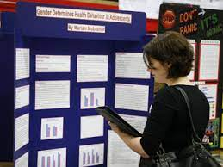
In Person Judging ….
We are planning to be back to in person judging after 3 years of remote judging.
I am really excited to see and talk to both you and the students once again.
For those of you that were part of the remote judging – a most sincere THANK YOU!

Slide 4
Today we will be:
Reviewing the timelines for students and judges
Discussing the Judging score sheet – 5 criterion
Discussing the Judging assignments & marks submission
Reviewing confidentiality
Sharing hints on in person judging
Taking questions from you

Slide 5
IMPORTANT JUDGING DATES:
Student registration closes March 5, 2023
Students’ last day for project submission is March 7, 2023
Merit Judges receive their assignments March 17, 2023
Merit Judging at Mohawk College, Fennell Campus Hamilton, Friday March 24, 2023
Open house, Saturday March 25, 2023, 9am- 12pm
Awards night at Mohawk CollegeTuesday March 28, 7 – 9 pm

Slide 6
Judges Resources
Event schedule – includes judging times https://www.basef.ca/calendar/
Description of student project levels and divisions https://www.basef.ca/levels-and-divisions/
Judging form https://www.basef.ca/wp-content/uploads/Judging/2023-Judging-Form.pdf
Under the “Getting Started” header you will find all the resources available to students organized by their level
Project resources list. - gives support to all students and their parents and teachers https://www.basef.ca/project-resources/
Eligibility rules are listed at https://www.basef.ca/eligibility-rules/
FYI – the 2023 Fair limit is 14 projects per school per level.

Slide 7
Evaluation Criteria Score
Criterion 1 – Scientific thought | / 45
Criterion 2 – Abstract | / 5
Criterion 3 – Display | / 10
Criterion 4 – Interview | / 20
Criterion 5 – Journal/Diary/Notebook | / 20
Score TOTAL | / 100

Slide 8
CRITERIA 1 – Scientific Thought Use the rubric provided to determine the score of the project by matching the description with the project.

Slide 10
CRITERIA 2 – Abstract
Does the abstract contain all aspects of the project? Is the information concise, complete, and accurate? Is the abstract well written? (grammar, syntax and spelling) Maximum 2 pages. | RATING: /5

Slide 11
CRITERIA 3 – Display (Backboard)
Is the content clearly and logically presented? Does it capture attention? Does it have impact? Is there good balance and use of contrasts? Does it contain visuals as well as text? Is workmanship neat and carefully done – no spelling or grammatical errors? Are colours strong and suitable? Does it summarize all the important facts? Is the layout complete, logical and self-explanatory? | RATING: /10

Slide 12
CRITERIA 4 – Interview
Is the project well explained/ summarized? Does the student(s) speak about things not included in the abstract and report? Can they answer questions about the project clearly? Is the hypothesis answered? Is there recognition of the potential impact of the project? Limitations of the project? For team projects, contributions and understanding evident by both members? | RATING: /20
Remember – as a Merit Judge you represent professional authority. Therefore, it is imperative that you conduct yourself in an appropriate manner. Questions, suggestions and comments made should always provide encouragement for continued effort.

Slide 13
CRITERIA 5 – Journal / Project Diary/ Notebook
Does the journal/ diary or notebook show evidence of: Initial brainstorming on possible problems/questions to explore Planning How and when the work was done and data collected Any obstacles and problems encountered Optional – student(s) may include sample photos of experiments in progress | RATING: /20

Slide 14
No Scientific research is totally original.
As a Merit Judge you are asked to give attention to the individual contribution by the student.
They should be neither penalized nor rewarded for receiving help that is properly acknowledged.

Slide 15
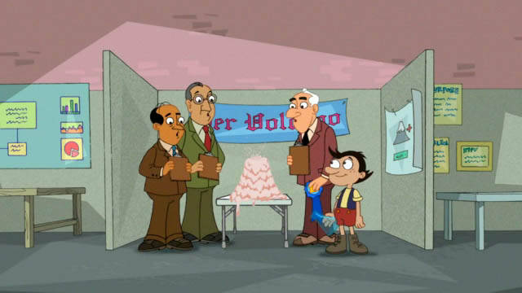
Sharing your thoughts matters….
Overall Impressions: Please add any comments or impressions that you have about the project which you found particularly compelling.
Areas for Improvement: Explain how the participants could have scored higher. Your comments may be used to provide feedback to the judging committee and to participants who ask for tips to improve a project.

Slide 16
Judging assignment – Assigned projects & Submitting marks

Slide 17
Judging Hints….
From the Judge in Chief ….
From others…..
Criteria missing? … what to do….
Remember what you say to the students will be remembered and quoted!

Slide 18
Confidentiality of Information

Slide 19
ZOOM Q & A
Over to you… what questions, concerns or comments do you have?

Slide 20
Thank you!
Students finalists overwhelmingly say that the most significant interactions that they have at the fair are with the judges.
Likewise, judges find their discussions with these outstanding students to be positive and uplifting experiences.
Ideally students grow academically and personally from their experience at BASEF.

