Slide 1
HOW CAN I HELP?
What is BASEF and how can I help make the Fair a success?

Slide 2
The Bay Area Science and Engineering Fair is the second largest regional Science Fair in Canada.

Slide 3
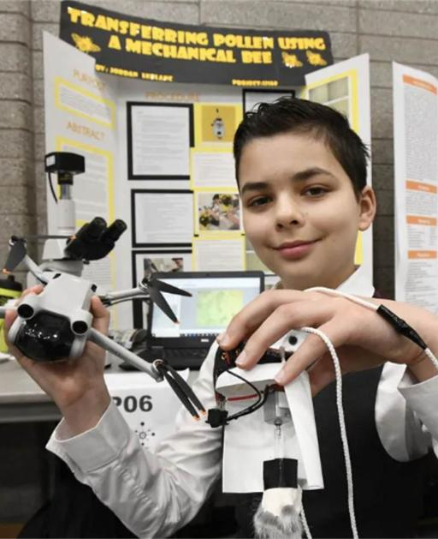
What is a Science Fair Project?
Students choose a topic that they are passionate about and prepare a science fair project. They present their projects at their annual science fair before a team of judges and the public, with a chance to receive medals, cash prizes and/or scholarships for their work.
Science fair projects aim to foster students' curiosity, critical thinking, and scientific inquiry skills. These projects cover a wide range of scientific disciplines such as biology, chemistry, physics, environmental science, engineering, and more.

Slide 4
Science Fair Structure
A regional Science Fair is part of a National Science Fair Structure
Students compete in their school science fairs or prepare an independent project.
Students who were chosen from their school fairs or prepare an independent project compete at the Regional fair.
Students are chosen at the regional fair to compete at the National or International fair levels

Slide 5
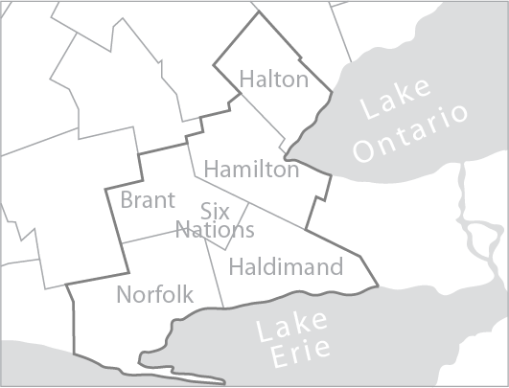
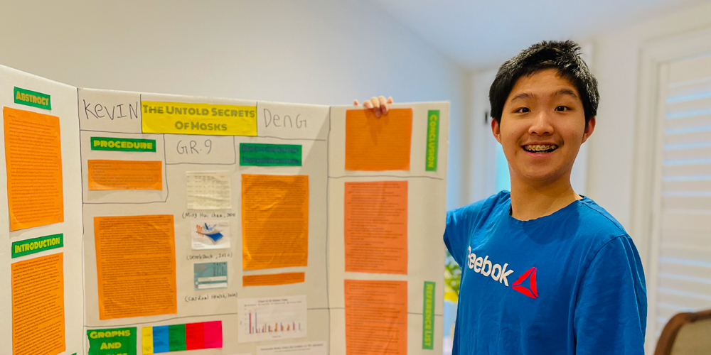
What is BASEF?
The Bay Area Science and Engineering Fair is a competition for all grade seven through twelve students from Hamilton, Halton Region, Haldimand County, Norfolk County, County of Brant, and Six Nations.
Students may attend any public, separate, or private school, or be homeschooled.
BASEF inspires young people to change the world through science, technology, engineering and mathematics.
BASEF provides opportunities for students to showcase their innovations and discoveries.

Slide 6
The BASEF Fair - 2024
The BASEF Science Fair is a 4 day event taking place at Hillfield Strathallan College and Mohawk College in Hamilton.
March 20th | Registration | Students set their projects up and receive a safety inspection.
March 21st | Judging | Students present their projects to various judges throughout the day.
March 22nd | Public Viewing | The Science Fair is open to the general public for viewing.
March 28th | Awards Ceremony | Students receive awards, cash prizes and scholarships for their work.

Slide 7
340 students
70 schools
BASEF 2024
150 merit awards
258 projects
145 special awards
Total awards in excess of $200 000

Slide 8
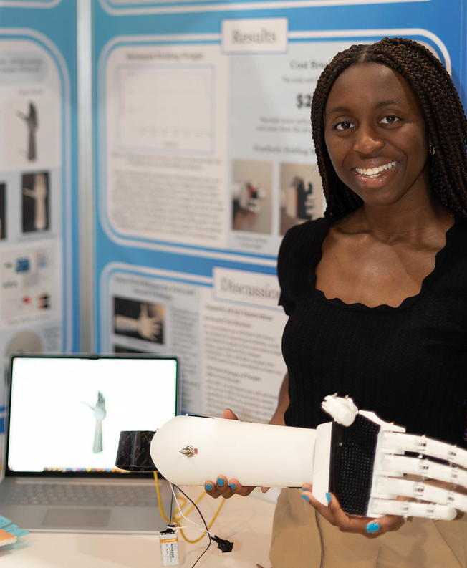
“BASEF is an amazing community of like-minded students, who live and breathe the STEM lifestyle. It is a pathway to a new lifestyle in which everything can be challenged or improved, and no question can go unanswered.”

Slide 9
We owe the success of BASEF to…
Our many Volunteers and the BASEF committee
Our generous sponsors and donors
Teachers, Parents, Mentors and Schools
SO HOW CAN I HELP?

Slide 10
Volunteer your time! Even a little goes a long way!

Slide 11
Volunteer Opportunities
The BASEF Science Fair is a 4 day event with opportunities to volunteer every day!
March 20th All day | Registration | Help set up project tables, handout t-shirts and goodie bags and direct students.
March 21st Morn/Aft | Judging | Chaperone students during judging day and help judges navigate the project floor.
March 22nd Morning | Public Viewing | Greet visitors, chaperone visitors and students, and direct the public to projects.
March 28th Evening | Awards Ceremony | Assist with set up and take down of the ceremony and guide students to the stage.

Slide 12
How can I volunteer?
Register
Email
Signing up to Volunteer at this year’s BASEF fair is easy!
OR
Fill in the link below with the general details of how and when you would like to volunteer and we will get in touch with you!
Link to Register:
If you have further questions about how you can volunteer, send us an email and we will help you help us!
Email: volunteers@basef.ca
https://forms.office.com/r/Q83uY3gQVu
Volunteer Registration Deadline is March 1st 2025

Slide 13
Find out more about BASEF!
Website
Facebook
Twitter
Instagram
https://www.basef.ca/
https://www.facebook.com/TeamBASEF/
https://twitter.com/basef/
https://www.instagram.com/basef/

Slide 14
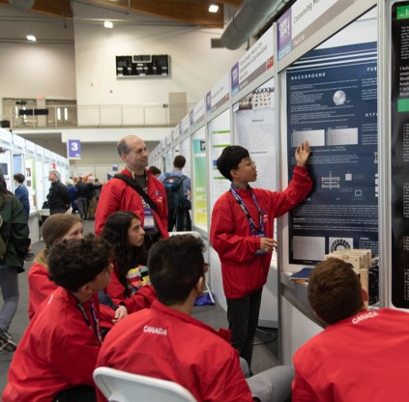
“BASEF isn’t just a Science Fair; it’s a glimpse into the future of our community.”

